Slide 1
Classification
Classification Performance

Slide 2
Model Evaluation
Classification Performance
Metrics for Performance Evaluation
How to evaluate the performance of a model?

Slide 3
Class Imbalance Problem
Data sets with skewed class distributions are common in real life applications
Defective products in an assembly lines
Fraudulent credit card transactions are outnumbered by legitimate transactions
Malicious attacks on web sites
In both cases, there are disproportionate no. of instances that belong to different classes
Six-sigma principle: 4 defects in 1m products
1% fraudulent transactions
Imbalance causes a no. of problems to existing classification algorithms
Accuracy measures not appropriate!!

Slide 4
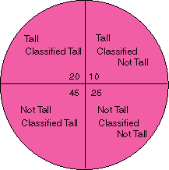
Classification Performance
True Positive
False Negative
False Positive
True Negative

Slide 5
Measuring Performance

Slide 6
Classifier Accuracy Measures
Accuracy of a classifier on a given test set is the %age of test set tuples that are correctly classified by the classifier
In pattern recognition literature, it is called ‘recognition rate’
Reflects how well the classifier recognizes tuples of various classes
Error rate or misclassification rate of a classifier M is 1 – Acc(M), where Acc(M) is the accuracy of M

Slide 7
Alternative Measures
Example: we trained a classifier to classify medical data tuples as either ‘cancer’ or ‘not_ cancer’
90% accuracy rate – sounds good
What if only 3-4% of training set tuples are actually ‘cancer’?
Classifier could be correctly labeling only the not_cancer tuples
How well the classifier recognizes ‘cancer’ tuples (+ tuples) and how well it can recognize not_cancer tuples (- tuples)?
USE Sensitivity & Specificity respectively

Slide 8
Alternative Measures
Sensitivity (True + or recognition)
Specificity (False +)
In addition, we may use ‘precision’ to assess the %age of tuples labeled as ‘cancer’ that actually are cancer tuples
Sensitivity = #(True +)/+
Specificity = #(True -)/-
Precision = #(True +)/(#(True +) + #(False +))
where #(True +) is the no. of true positives (cancer tuples that were correctly classified)
+ is the no. of ‘cancer’ tuples
#(True -) is the no. of true negatives (not_cancer tuples that were correctly classified as such)
- is the no. of ‘not_cancer’ tuples
#(False +) is the no. of false positives (‘not_cancer’ incorrectly labelled as ‘cancer’)

Slide 9
Alternative Measures
It can be shown that Accuracy as a function of Sensitivity and Specificity
Accuracy = Sensitivity ((pos)/(pos+neg) )
+ Specificity ((neg)/(pos+neg) )
Other cases where ‘accuracy’ not appropriate?
Assumption: each tuples belongs to only one class?
Rather than returning a class label, it is useful to return a probability class distribution
A classification is considered correct if it assigns a tuple to first or the second most probable class

Slide 10
Metrics for Performance Evaluation
Focus on the predictive capability of a model
Rather than how fast it takes to classify or build models, scalability, etc.
Confusion Matrix:
 | PREDICTED CLASS
ACTUAL CLASS |  | Class=Yes | Class=No
 | Class=Yes | a | b
 | Class=No | c | d
a: TP (true positive)
b: FN (false negative)
c: FP (false positive)
d: TN (true negative)

Slide 11
Metrics for Performance Evaluation…
Most widely-used metric:
 | PREDICTED CLASS
ACTUAL CLASS |  | Class=Yes | Class=No
 | Class=Yes | a (TP) | b (FN)
 | Class=No | c (FP) | d (TN)

Slide 12
Limitation of Accuracy
Consider a 2-class problem
Number of Class 0 examples = 9990
Number of Class 1 examples = 10
If model predicts everything to be class 0, accuracy is 9990/10000 = 99.9 %
Accuracy is misleading because model does not detect any class 1 example

Slide 13
Cost Matrix
 | PREDICTED CLASS
ACTUAL CLASS | C(i|j) | Class=Yes | Class=No
 | Class=Yes | C(Yes|Yes) | C(No|Yes)
 | Class=No | C(Yes|No) | C(No|No)
C(i|j): Cost of misclassifying class j example as class i

Slide 14
Computing Cost of Classification
Cost Matrix | PREDICTED CLASS
ACTUAL CLASS | C(i|j) | + | -
 | + | -1 | 100
 | - | 1 | 0
Model M₁ | PREDICTED CLASS
ACTUAL CLASS |  | + | -
 | + | 150 | 40
 | - | 60 | 250
Model M₂ | PREDICTED CLASS
ACTUAL CLASS |  | + | -
 | + | 250 | 45
 | - | 5 | 200
Accuracy = 80%
Cost = 150x-1+60x1+40x100 =3910
Accuracy = 90%
Cost = 250x-1+5x1+45x100 =4255

Slide 16
Cost vs Accuracy
Accuracy is proportional to cost if 1. C(Yes|No)=C(No|Yes) = q 2. C(Yes|Yes)=C(No|No) = p
Count | PREDICTED CLASS
ACTUAL CLASS |  | Class=Yes | Class=No
 | Class=Yes | a | b
 | Class=No | c | d
N = a + b + c + d
Accuracy = (a + d)/N
Cost = p (a + d) + q (b + c)
= p (a + d) + q (N – a – d)
= q N – (q – p)(a + d)
= N [q – (q-p) × Accuracy]
Cost | PREDICTED CLASS
ACTUAL CLASS |  | Class=Yes | Class=No
 | Class=Yes | p | q
 | Class=No | q | p

Slide 17
Cost-Sensitive Measures
Precision is biased towards C(Yes|Yes) & C(Yes|No)
Recall is biased towards C(Yes|Yes) & C(No|Yes)
F-measure is biased towards all except C(No|No)

Slide 18
Operating Characteristic Curve
OC Curve (operating characteristic curve) or ROC curve (receiver operating characteristic curve)
Developed in 1950s for signal detection theory to analyze noisy signals
Characterize the trade-off between positive hits and false alarms
Shows relationship between FPs and TPs
Originally used in communications area to examine false alarm rates
Used in IR to examine fallout (%age of retrieved that are not relevant) versus recall (%age of retrieved that are relevant)

Slide 19
ROC (Receiver Operating Characteristic)
Operating Characteristic Curve
ROC curve plots TP (on the y-axis) against FP (on the x-axis)
Performance of each classifier represented as a point on the ROC curve
changing the threshold of algorithm, sample distribution or cost matrix changes the location of the point

Slide 20
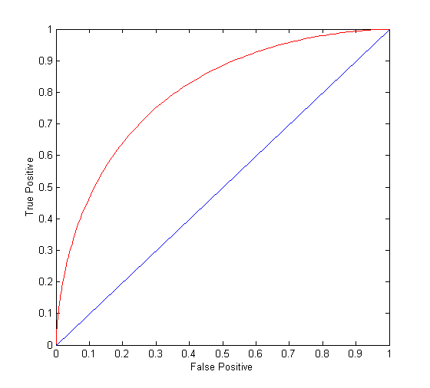
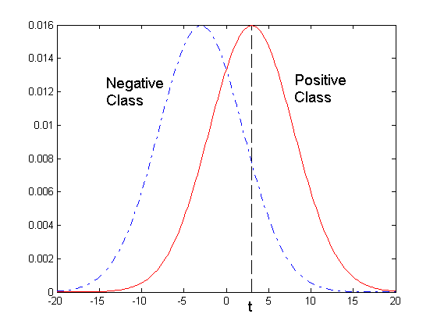
ROC Curve
- 1-dimensional data set containing 2 classes (positive and negative)
- any points located at x > t is classified as positive
At threshold t:
TP=0.5, FN=0.5, FP=0.12, FN=0.88

Slide 21
ROC Curve
(TP,FP):
(0,0): declare everything to be negative class
(1,1): declare everything to be positive class
(1,0): ideal
Diagonal line:
Random guessing
Below diagonal line:
prediction is opposite of the true class

Slide 22
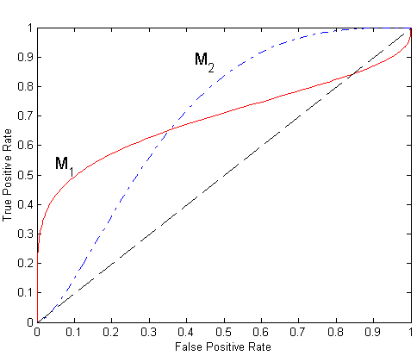
Using ROC for Model Comparison
No model consistently outperform the other
M₁ is better for small FPR
M₂ is better for large FPR
Area Under the ROC curve
Ideal:
Area = 1
Random guess:
Area = 0.5

Slide 23
How to Construct an ROC curve?
Use classifier that produces posterior probability for each test instance P(+|A)
Sort the instances according to P(+|A) in decreasing order
Apply threshold at each unique value of P(+|A)
Count the number of TP, FP, TN, FN at each threshold
TP rate, TPR = TP/(TP+FN)
FP rate, FPR = FP/(FP + TN)
Instance | P(+|A) | True Class
1 | 0.95 | +
2 | 0.93 | +
3 | 0.87 | -
4 | 0.85 | -
5 | 0.85 | -
6 | 0.85 | +
7 | 0.76 | -
8 | 0.53 | +
9 | 0.43 | -
10 | 0.25 | +

Slide 24
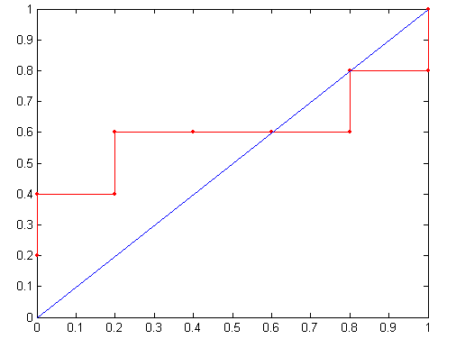
How to Construct an ROC curve?
Threshold >=
ROC Curve:

